Slide 1

Weekly Report: Week 0
GSP Team B

Slide 2

Progress
A visual representation of our timeline and progress should be shown here

Slide 3
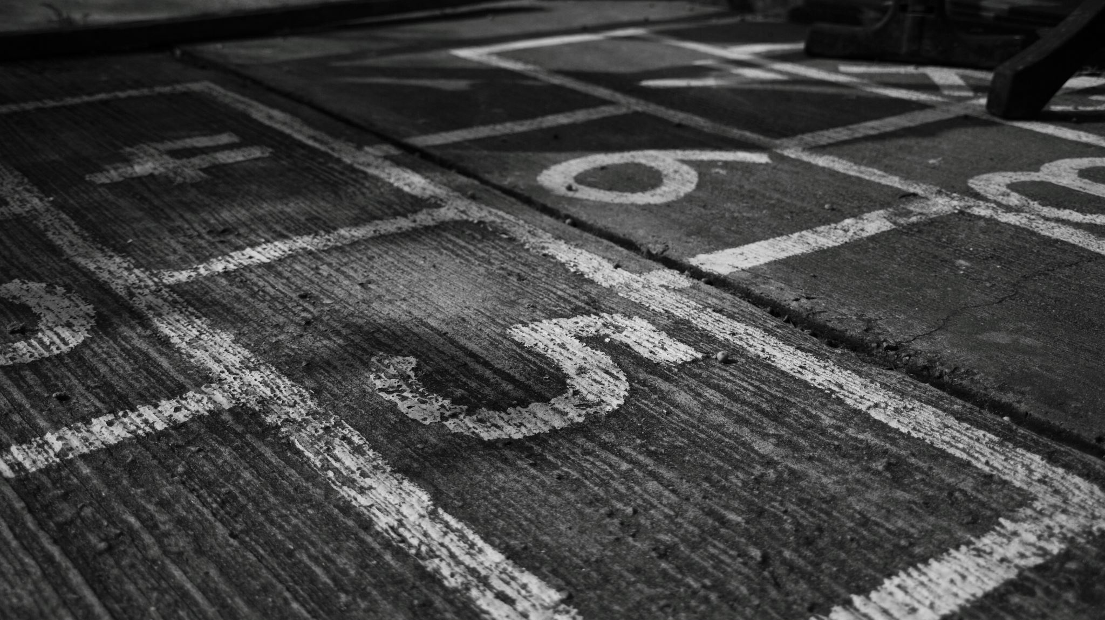
Key Milestones
17/03
Final concept arts done
17/03
Full white box level done
31/03
Large write up of GDD done
28/04
Finish modelling
05/05
Finish merging designs and mechanics
12/05
Playtest

Slide 4

Team Activity
Graphs and statistics on team activity and performance should go here

Slide 5

Summary
Any changes we have made in our plan since last time should be addressed here if they are relevant details.

Slide 6

Team Member Presentations
At this point each team member must present what they have been doing over the past week, so I advise using screenshots and 1 slide each.
Also include what your next weeks plans are.

Slide 7
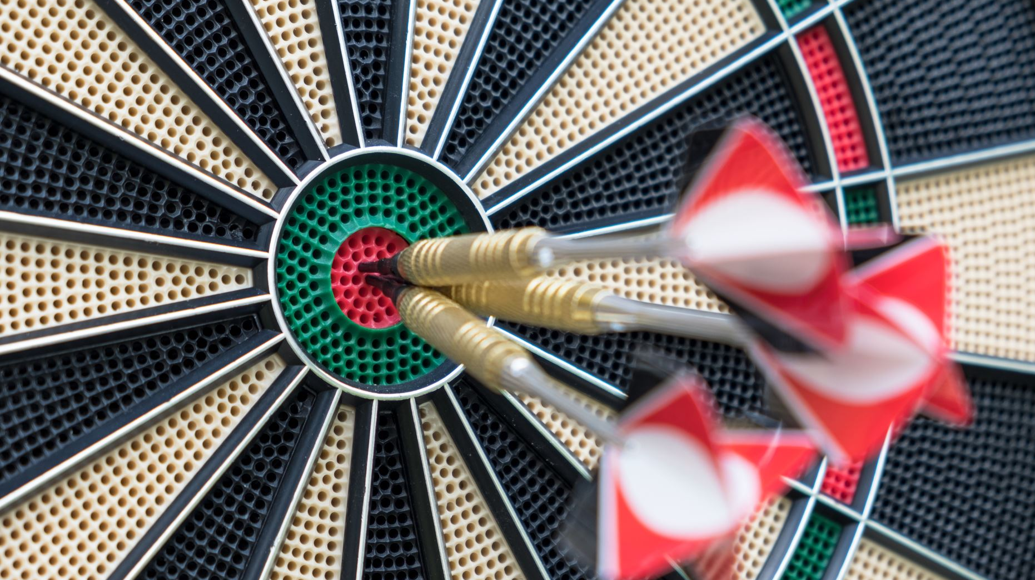
Next Weeks Targets
An overall summary of the next weeks goals should be made here. Relate it to timeline.

Slide 8

Challenges
Any issues that may hinder progress should be listed here.

Slide 9

Anything We Need Help With?
Any questions we have or advice we need should be asked for here

